Slide 1
Introduction to Python
Designed for New Coders

Slide 2
Housekeeping for Virtual Delivery
In case of technical problems:
Something wrong on my end (e.g. power outage), I will send you an email.
Something wrong on your end, please send me a text message. 508-769-6446

Slide 3
Before we begin…
There is very little straight lecture.
Most of the time we will be writing code
We will take frequent breaks. Most breaks will be attached to a workshop.
Ask questions at any time. If you ask via audio, please let me know who you are.
Feel free to ask via chat.

Slide 4
A little about me
Experience:
25+ years consulting and training experience
Extensive work with “big data” and analytics
Education
Ed. M., Technology, Innovation & Education, Harvard University
PhD Candidate, Education Policy University of Massachusetts, Amherst

Slide 5
Our goals for the course are:
Be able to use:
the core python library
Numpy
Pandas
Matplotlib
Seaborn
Be able to conduct a basic exploratory data analysis with visualizations using the libraries listed above.

Slide 6
Before we get into Python, let’s talk about data analysis.

Slide 7
Types of analyses
Descriptive
Exploratory
Inferential
Predictive
Causal
Mechanistic

Slide 8
Types of analyses
Descriptive
Exploratory
Inferential
Predictive
Causal
Mechanistic
” Here’s a dataset. Tell me something interesting.”

Slide 9
Is there a process to go from ‘tell me something…’ to ‘here is what we found’?

Slide 10
Looking for insights
Patterns
Trends
Outliers
Factoids
Interactions
Comparisons
Changes
Composition
Distribution
Clusters
Domain Knowledge
Start
Broad, general questions
?
Finish
no set path
duplicates
missing
quality
usefulness
bar charts
histograms
boxplots
correlations
new features
grouping (aggregation)
more questions
Questions – Round 2
more specific
may have answers that are not interesting

Slide 11
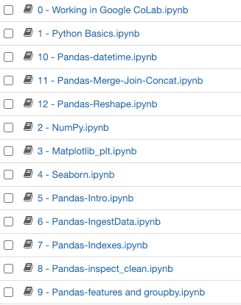
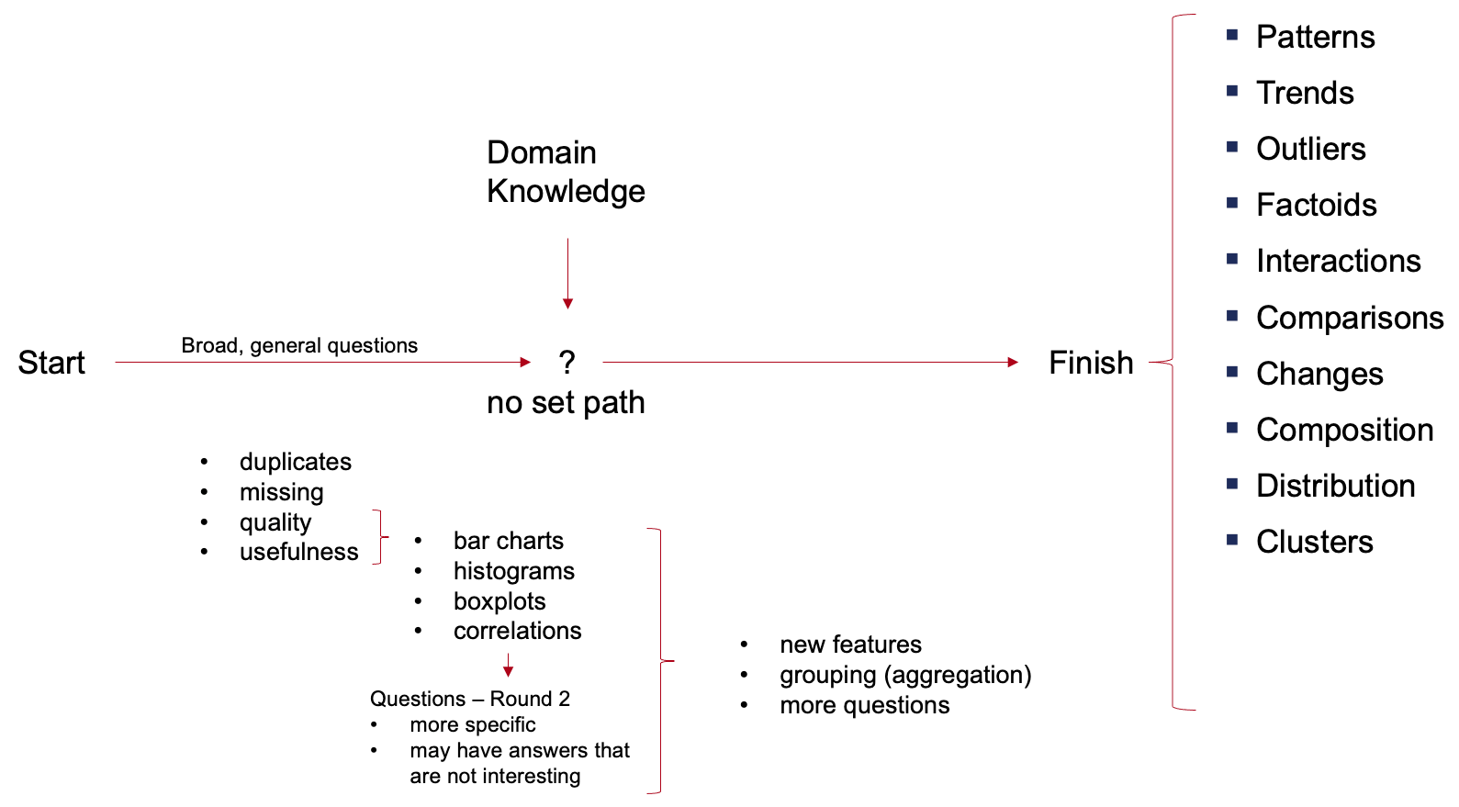
Approach to learning Python
A little coding background.
A high-level pass to learn a lot of basic functionality.
Expanding into more complex functionality.
Notes:
Starting in the deep end
A high level pass to learn a lot of basic functionality followed by more complex functionality.

Slide 12
Python

Slide 13
What is Python?
Python is a high-level, interpreted scripting language developed in the late 1980’s.
A scripting language is a programming language that is interpreted. It is translated into machine code when the code is run, rather than beforehand.

Slide 14
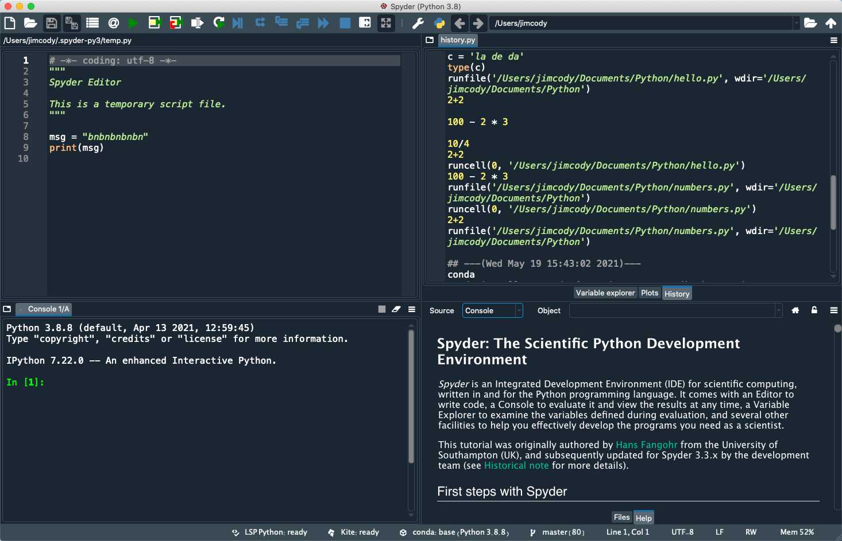
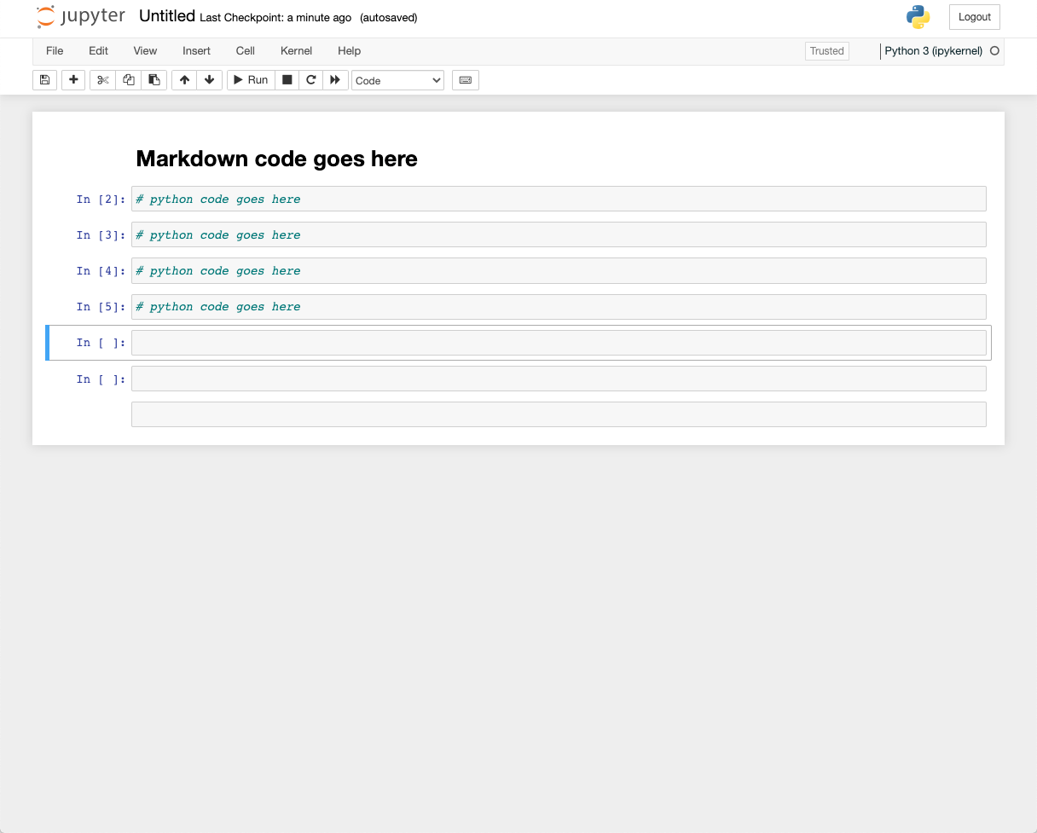
Two main working environments
IDE Environments & scripts
jupyter notebooks

Slide 15
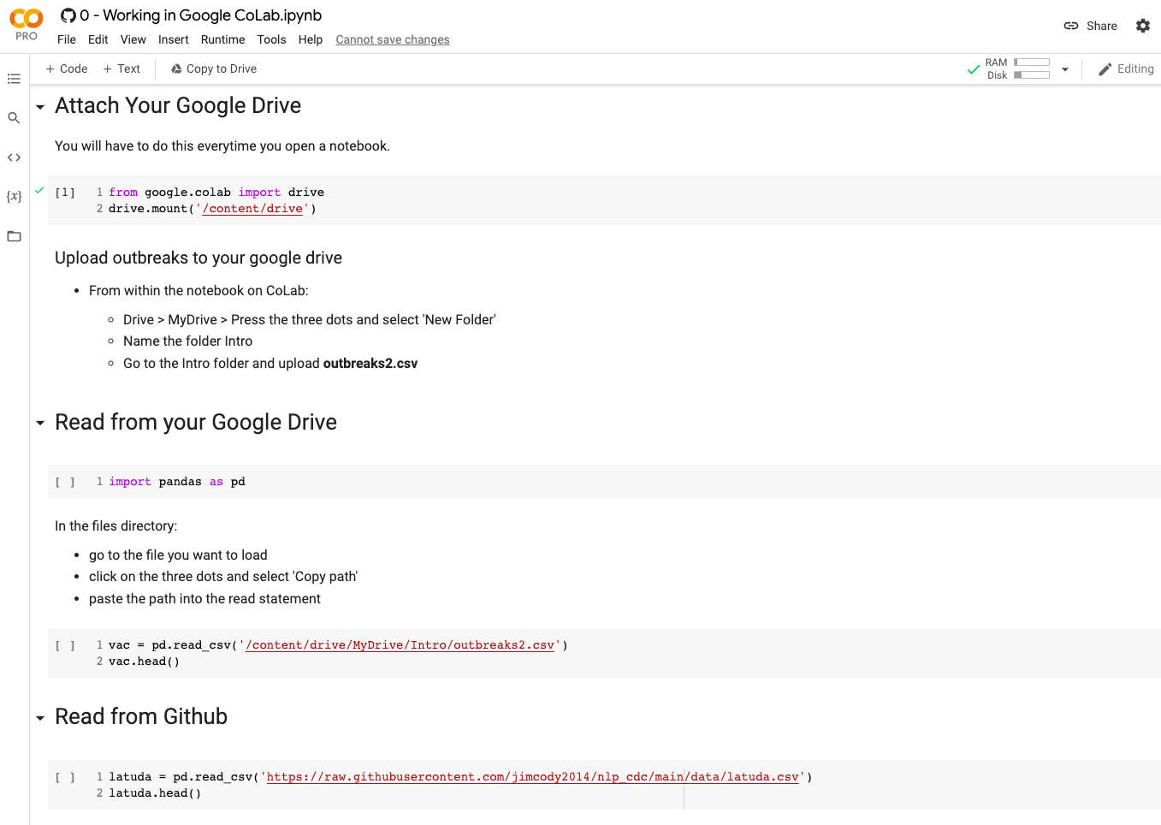
jupyter notebook on Google CoLab

Slide 16
Some terminology
Module
collection of functions
has a file extension .py
Package
collection of related modules
Library
a loose umbrella term
All packages are modules.
Not all modules are packages.
pandas.dataframe.info()
package
(sometimes called a library;
sometimes called a module)
module
(sometimes called a submodule)
function
Notes:
import matplotlib.pyplot as plt
from matplotlib import pyplot

Slide 17
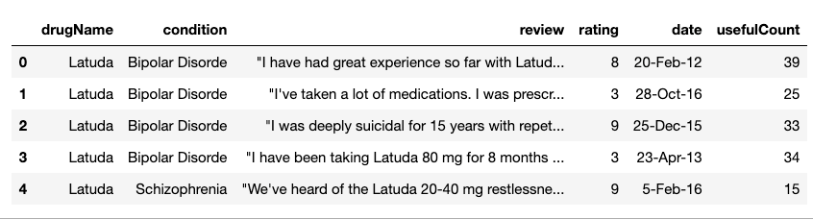
A few pandas basics
https://pandas.pydata.org/docs/reference/frame.html
Dataframe
column index
row index
dataframe attributes
df.columns
df.shape
df.axes
df.size
….
dataframe methods
df.head( )
df.tail( )
df.groupby( )
df.mean( )
df.drop_duplicates( )
….

Slide 18
Day 1 Recap

Slide 19
Important things we learned: Data structures
Data Structures
List [ ]
Tuple ( )
Set { }
Dictionary {:}
From Numpy
1d array
2d array
From Pandas
Series
Dataframe

Slide 20
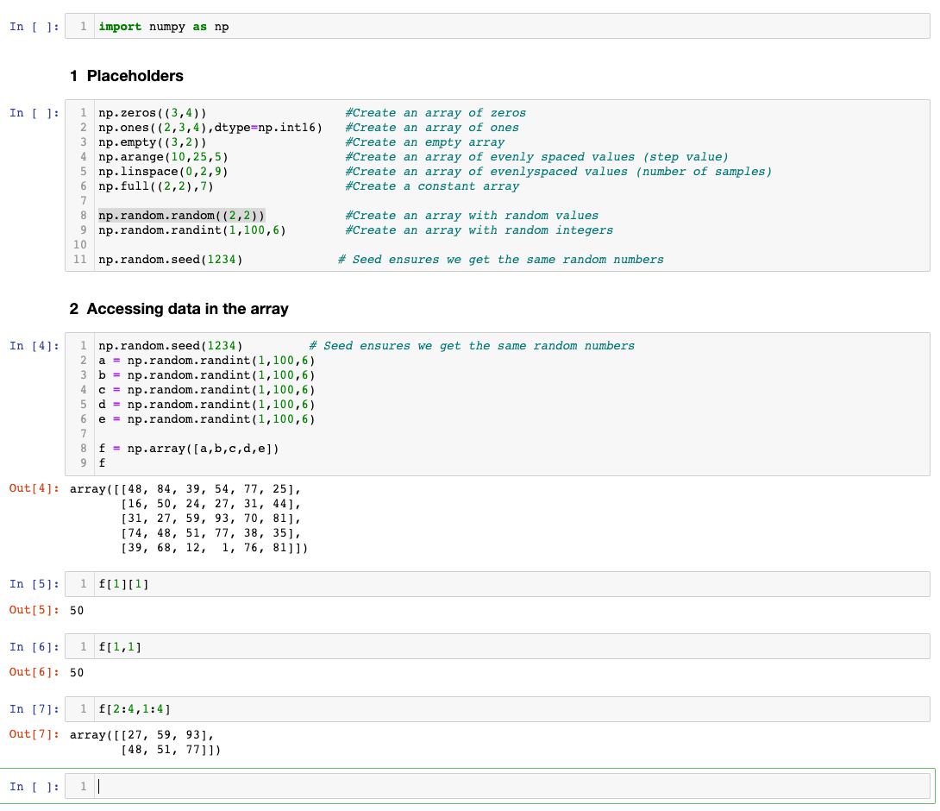
Important things we learned: Using array indexes

Slide 21
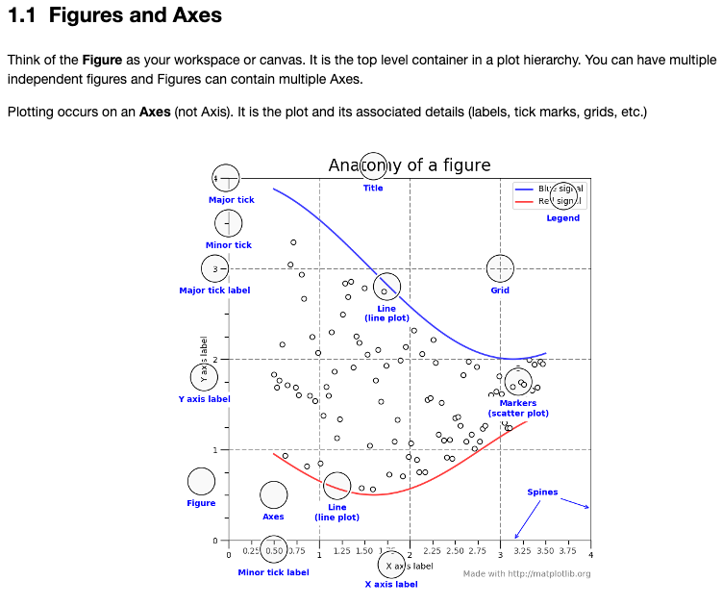
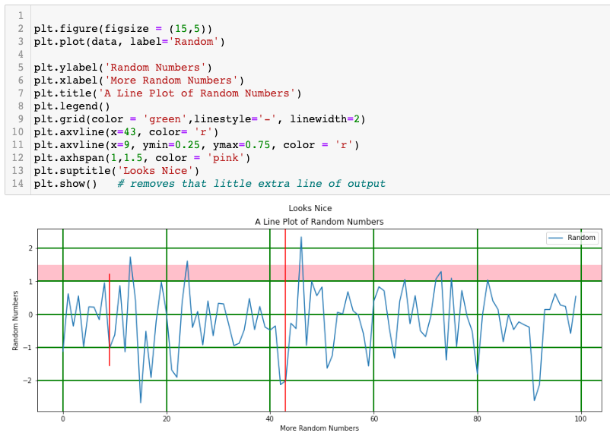
Important things we learned: Using array indexes

Slide 22
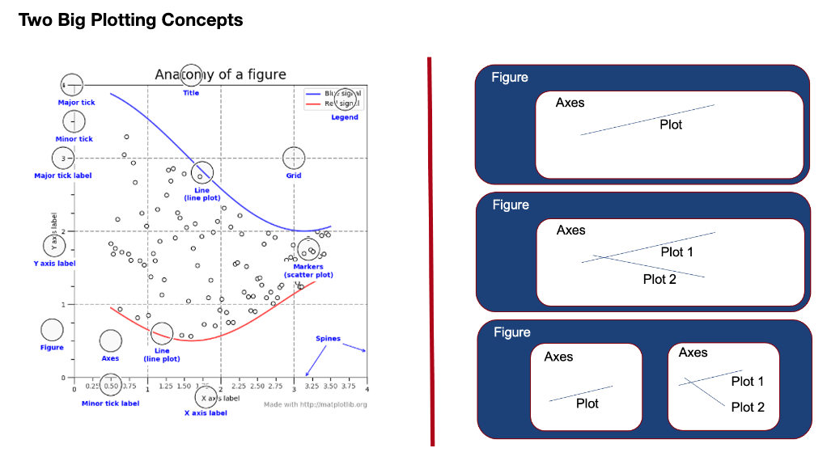
Something we did not learn

Slide 23
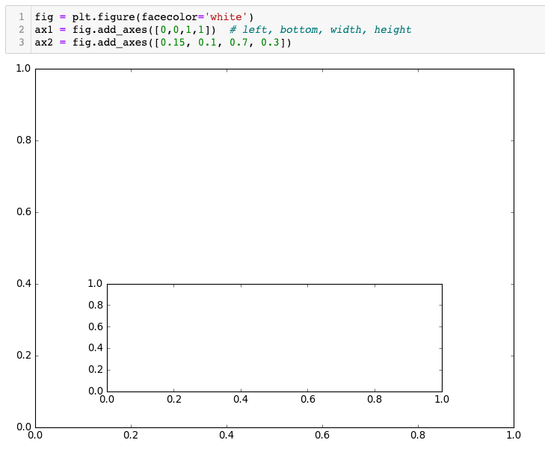
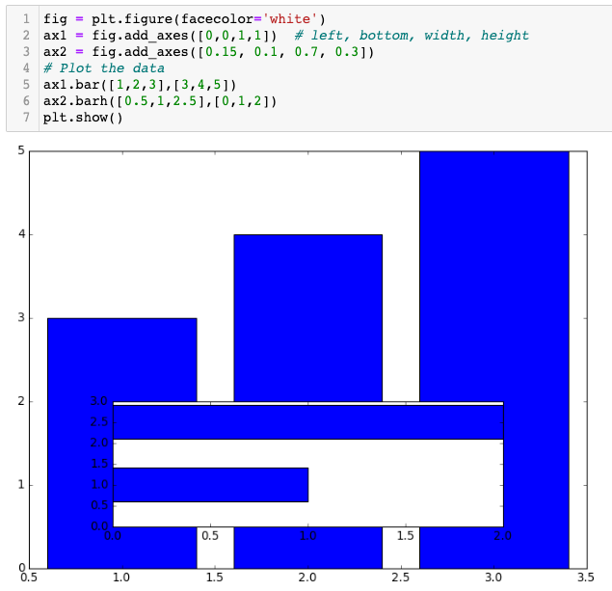
Matpotlib

Slide 24
Looking for insights
Patterns
Trends
Outliers
Factoids
Interactions
Comparisons
Changes
Composition
Distribution
Clusters
Domain Knowledge
Start
Broad, general questions
?
Finish
no set path
duplicates
missing
quality
usefulness
bar charts
histograms
boxplots
correlations
new features
grouping (aggregation)
more questions
Questions – Round 2
more specific
may have answers that are not interesting

Slide 25
Approach to learning Python
A little coding background.
A high-level pass to learn a lot of basic functionality.
Expanding into more complex functionality.
Notes:
Starting in the deep end
A high level pass to learn a lot of basic functionality followed by more complex functionality.

